Slide 1
CORTANA ENABLED DESK
A COMPLETE ROOM AUTOMATION SYSTEM USING VOICE COMMANDS

Slide 2
INTRODUCTION
Worlds demand for electricity had grown 87% between 2010 and 2018this increase is more than today’s total use of electricity in India , USA, Japan, Australia combined. We can’t decrease the electricity growth rate but we can lessen the amount of electricity wasted each year by turning off our home appliances when not in use
We saw many home automation technologies introduced over these years from Zigbee, Google Home and Home from Apple.

Slide 3
Introduction(cont.…)
Google Home price around 150$(USD) with an additional cost of the devices to be connected to the total cost of the system reaches over 250$(USD).
Apple Home Kit tool is pretty more expensive ,over 100$(USD) more than Google Home just for basic setup.
So, overall we can see here that to make our home smart we need to invest quite a lot, let’s say some 250$(USD) for even basic setup

Slide 4
Introduction(cont..)
This system describes the implementation of a cost effective system that can be used to control the appliances in a room automatically.
Using this system we can turn ON/OFF the devices in a room with voice commands alone
So the main advantage of the system is that we don’t need to go near to each switches to control these devices instead of that we can operate it according to our convenience.

Slide 5
Introduction(cont..)
If people feel too tired that they find it hard to move once they land on their couch, sofa or bed, it is easy for them to switch their lights on or off, or play their favorite music etc. on a go with their voice with the aid of their smart phones would make their home more comfortable.
This system uses Google Assistance ,IFTTT application, Blynk application and NodeMCU as the major components along with a Relay board comprising of 4.8 replays.
Natural Language voice is used to give commands to Google assistant. All of the components are connected over the internet using Wi-Fi which put this system under the IoT

Slide 6
System design
The system design is broken into two main categories
1. Hardware
It has the capability to connect to the router. It would also be able to turn on/off specified devices, such as lights and fans. It is called the ‘Control Unit’. The hardware also called the Control Unit comprises of the NodeMCU microcontroller and the Realy board. NodeMCU’s digital output pins are connected to the Relay pins of the Relay board. Finally, each Relay is connected to an appliance.
2.Software
The software of the system proposed consists of mainly the Blynk Application and the IFTTT application.

Slide 7
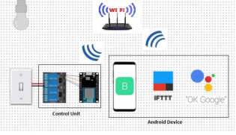
Basic system architecture

Slide 8
hardware
Hardware used here are,
NodeMCU(ESP8266)
Relay Board
Bread Board
Jumper Cables
LEDs and battery

Slide 9
NodEMCU(ESP8266)
The NodeMCU (Node MicroController Unit) is an open source software and hardware development environment that is built around a very inexpensive System-on-a-Chip (SoC) called the ESP8266.
The ESP8266 is designed and manufactured by Express, contains all crucial elements of the modern computer: CPU, RAM, networking (Wi-Fi), and even a modern operating system and SDK. When purchased at bulk, the ESP8266 chip costs only $2 USD a piece. That makes it an excellent choice for this system design.

Slide 10
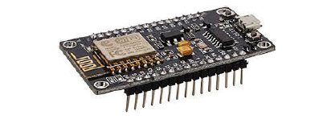
NodEMCU(ESP8266)

Slide 11
Relay board
A relay is an electromagnetic switch. It is activated when a small current of some microampere is applied to it.
Normally a relay is used in a circuit as a type of switch, an automatic switch. There are different types of relays and they operate at different voltages.
When a circuit is built the voltage that will trigger it has to be considered. In this system the relay circuit is used to turn the appliances ON/OFF. The high/low signal is supplied from the NodeMCU microcontroller. When a low voltage is given to the relay of an appliance it is turned off and when a high voltage is given it is turned on.

Slide 12
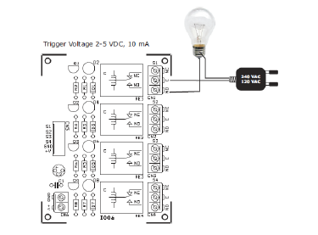
Relay board wiring diagram

Slide 13
Breadboard
A breadboard is a solderless device for temporary prototype with electronics and circuit designs. Most electronic components in electronic circuit can be interconnected by inserting their leads or terminals into holes and then making connection through wires where appropriate.
The breadboard has strips of metal underneath the board and connect the holes on the top of the board. In the board the top and the bottom rows of holes are connected horizontally and split in the middle while the remaining holes are connected vertically.
Because, the solderless breadboard does not requires soldering it is reusable. This make it easy to use for creating temporary prototypes and experimenting with circuit design

Slide 14
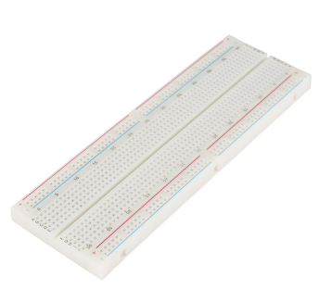
breadboard

Slide 15
Jumper wires
Jumper wires are simply wires that have connector pins at each end, allowing them to be used to connect two points to each other without soldering. Jumper wires are typically used with breadboard and other prototyping tools in order to make it easy to change a circuit as needed.
Through jumper wires comes in variety of colors, the color don’t actually mean anything. This means that red wires is same as a black one. But the color can be used to differentiate between types of connections.

Slide 16
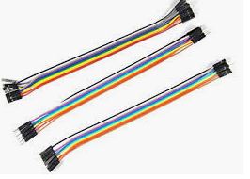
Jumper wires

Slide 17
Led and battery
A light-emitting diode(LED) is a semiconductor light source that emits light when the current flows through it.
LEDs have many advantages over incandescent light sources, such as:
Lower Energy Consumption
Longer Lifetime
Improved Physical Robustness
Smaller Size
Faster Switching
Here we use 9V normal battery

Slide 18
software
The software's used here are,
BLYNK APPLICATION
IFTTT APPLICATION

Slide 19
Blynk application
Blynk is a Platform with iOS and Android apps to control Arduino, Raspberry Pi, NodeMCU and several other boards over the Internet.
Blynk was designed for the Internet of Things. It can control hardware remotely, it can display sensor data, it can store data, visualize it and do many other cool things.
Blynk App setup is required; we set it up as per the requirement. We begin by creating a project and then selecting the microcontroller we are using. After which we create the toggle buttons for each relay associated with the digital pins of the microcontroller. Once this is done, Blynk sends an authentication token to the registered email id for this particular project. This token should be noted and saved for its use while programming the NodeMCU and setting up the IFTTT application.

Slide 20
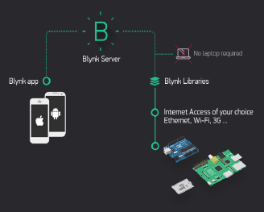
Functioning of blynk application

Slide 21
Ifttt application
IFTTT derives its name from the programming conditional statement “if this, then that.”
IFTTT is both a website and a mobile app that launched in 2010 and has the slogan "Put the Internet to work for you". The idea is that you use IFTTT to automate everything from your favorite apps and websites to app-enabled accessories and smart devices.
Here, IFTTT application is used to bridge the gap between the Google Assistant commands and the Blynk app.

Slide 22
Ifttt application
Setting up the IFTTT application first requires logging in after which we need to create an applet and then “This”, i.e. the trigger, here we select Google Assistant and then we will type in the commands to which the Google Assistant should respond and to this command it should control the appliance/relay associated with it. The response command from the Goggle Assistant can also be typed in as desired.

Slide 23
Ifttt application
After configuring the trigger, i.e. “This” of the application we need to configure the “That”. What should be done once the Google Assistant hears the command which we just configured? This is decided by setting “That” of the app. We click “That” and then select webhooks and click connect. Webhooks will allow us to send commands to the Blynk Server. Now, in the URL we type the IP address of the Blynk server followed by the Authentation token sent by the Blynk and then the pin number of the microcontroller to which the device to be controlled is connected. The URL should be in the following format:
http://188.166.206.43/AuthToken/pin/CorrespondingDigitalPinNo

Slide 24
Ifttt application
Then in the method we select ‘PUT’ and the content type is ‘Application/JSON’ [8] and in the body we write [“1”] to turn ON and [“0”] to turn OFF. This creates the action for the trigger i.e. the Google Assistant command. The action taken by it is simply sending a message to the Blynk app to either turn ON or OFF the concerned connected device.
Finally, the microcontroller is programmed with the actions it needs to do once it receives the signal from the Blynk application.

Slide 25
Before that, the Blynk and the microcontroller should communicate and the communication is done via the internet and since the microcontroller, NodeMCU comes with inbuilt Wi-Fi module, it is programmed to connect to the desired network once plugged in. ‘C’ language is used to program the microcontroller and is programmed in the Arduino IDE .

Slide 26
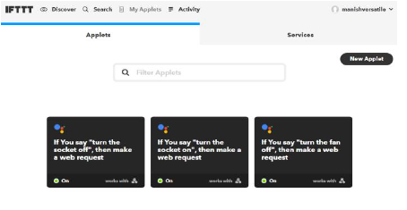
Ifttt application after creating applets

Slide 27
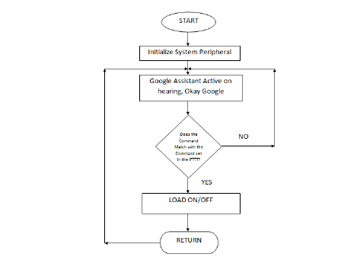
Flow chart

Slide 28
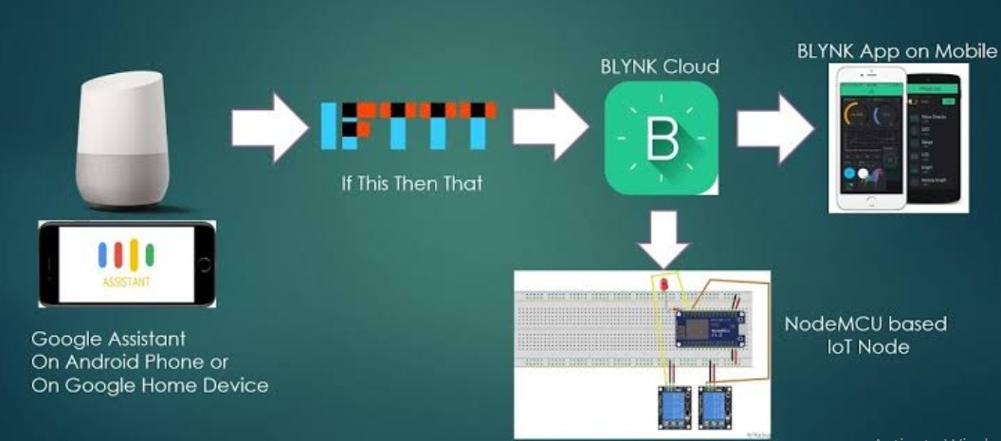
Working diagram

Slide 29
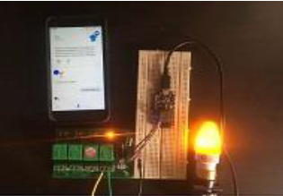
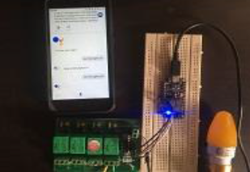
result
Lights turned ON/OFF corresponding to voice commands

